Slide 1
FIL SPM Course May 2011 Spatial preprocessing
Ged Ridgway
With thanks to John Ashburner
and the FIL Methods Group

Slide 2
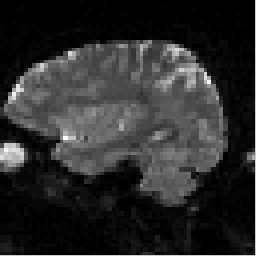
fMRI time-series movie
Notes:
Auditory example data

Slide 3
Preprocessing overview
REALIGN
COREG
SEGMENT
NORM WRITE
SMOOTH
ANALYSIS

Slide 4
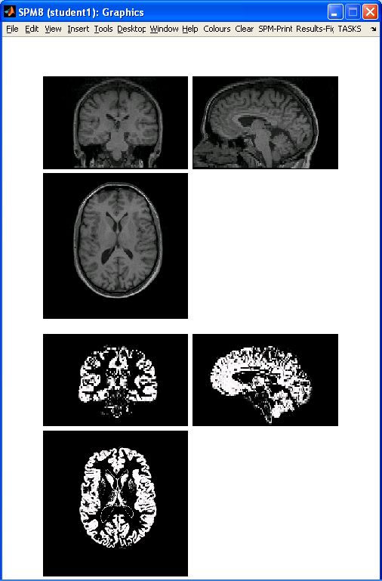
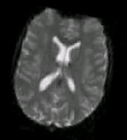
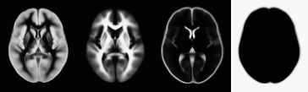
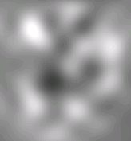
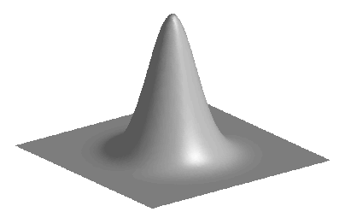
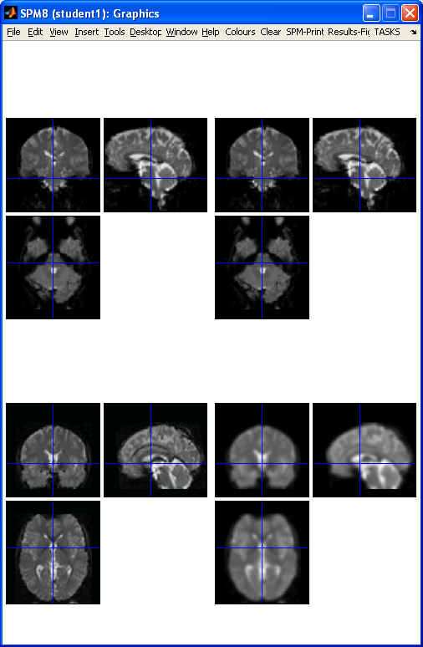
Preprocessing overview
Input
Output
fMRI time-series
Anatomical MRI
TPMs
Segmentation
Transformation
(seg_sn.mat)
Kernel
REALIGN
COREG
SEGMENT
NORM WRITE
SMOOTH
Mean functional
(Headers changed)
Motion corrected
MNI Space
ANALYSIS

Slide 5
Contents
Registration basics
Motion and realignment
Inter-modal coregistration
Spatial normalisation
Unified segmentation
Gaussian smoothing

Slide 6
Representation of imaging data
Three dimensional images are made up of voxels
Voxel intensities are stored on disk as lists of numbers
The image “headers” contain information on
The image dimensions
Allowing conversion from list -> 3D array
The “voxel-world mapping”
matrix subscripts -> world/physical/mm coordinates
Can rigidly reorient images by changing their (affine) voxel-world mapping

Slide 7
Types of registration in SPM
Manual reorientation
Rigid intra-modal realignment
Motion correction of fMRI time-series
Rigid inter-modal coregistration
Aligning structural and (mean) functional images
Affine inter-subject registration
First stage of non-linear spatial normalisation
Approximate alignment of tissue probability maps

Slide 8
Types of registration in SPM – Nonlinear
Spatial normalisation using basis functions
Registering different subjects to a standard template
Unified segmentation and normalisation
Warping standard-space tissue probability maps to a particular subject (can normalise using the inverse)
DARTEL / Geodesic Shooting
High-dimensional large-deformation warps from smooth flows
Normalisation to group’s average shape template

Slide 9
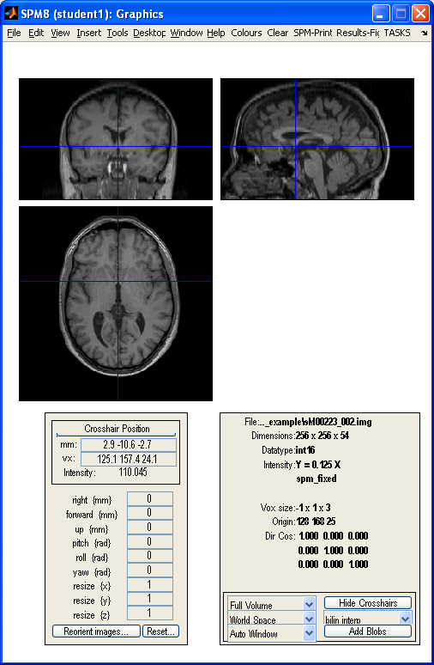
Manual reorientation
Image “headers” contain information that lets us map from voxel indices to “world” coordinates in mm
Modifying this mapping lets us reorient (and realign or coregister) the image(s)

Slide 10
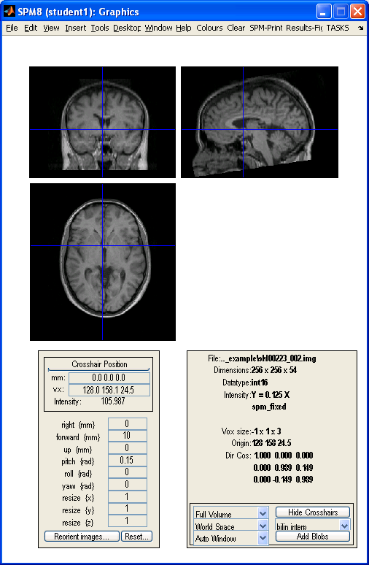
Manual reorientation

Slide 11
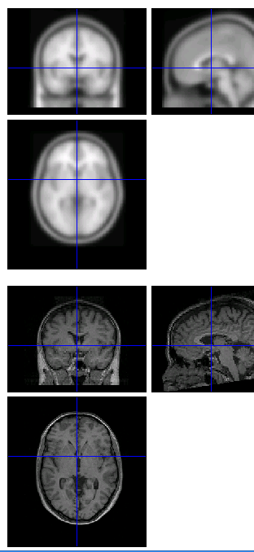
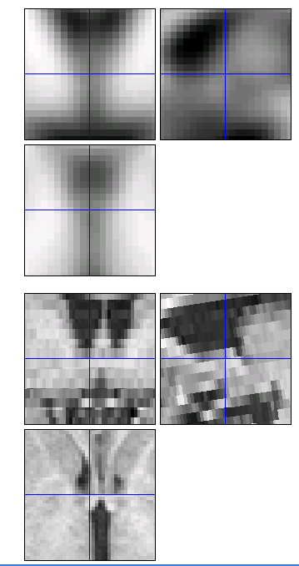
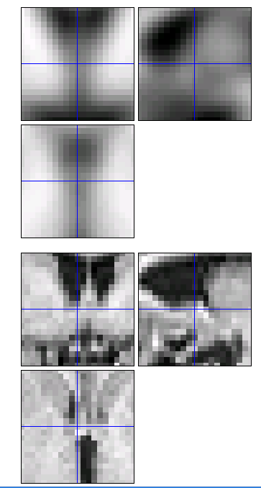
Manual reorientation – Reslicing
Reoriented (1x1x3 mm voxel size)
Resliced
(to 2 mm cubic)

Slide 12
Reslicing / Interpolation
Applying the transformation parameters, and re-sampling the data onto the same grid of voxels as the target image
AKA reslicing, interpolation, regridding, transformation, and writing (as in normalise - write)
Nearest neighbour gives the new voxel the value of the closest corresponding voxel in the source
Linear interpolation uses information from all immediate neighbours (2 in 1D, 4 in 2D, 8 in 3D)
NN and linear interp. correspond to zeroth and first order B-spline interpolation, higher orders use more information in the hope of improving results

Slide 13
Linear interpolation – 1D
f(x)
?
f(b)
f
f(a)
x
a
x
b

Slide 14
Linear interpolation – 1D
f(x)
f(1)
f(0)
x0
x1
0
x
1

Slide 15
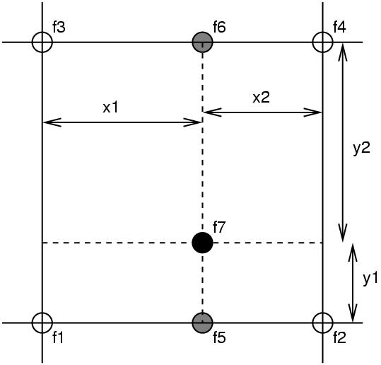
Linear interpolation – 2D
Nearest neighbour
Take the value of the closest voxel
Tri-linear
Just a weighted average of the neighbouring voxels
f₅ = f₁ x₂ + f₂ x₁
f₆ = f₃ x₂ + f₄ x₁
f₇ = f₅ y₂ + f₆ y₁

Slide 16
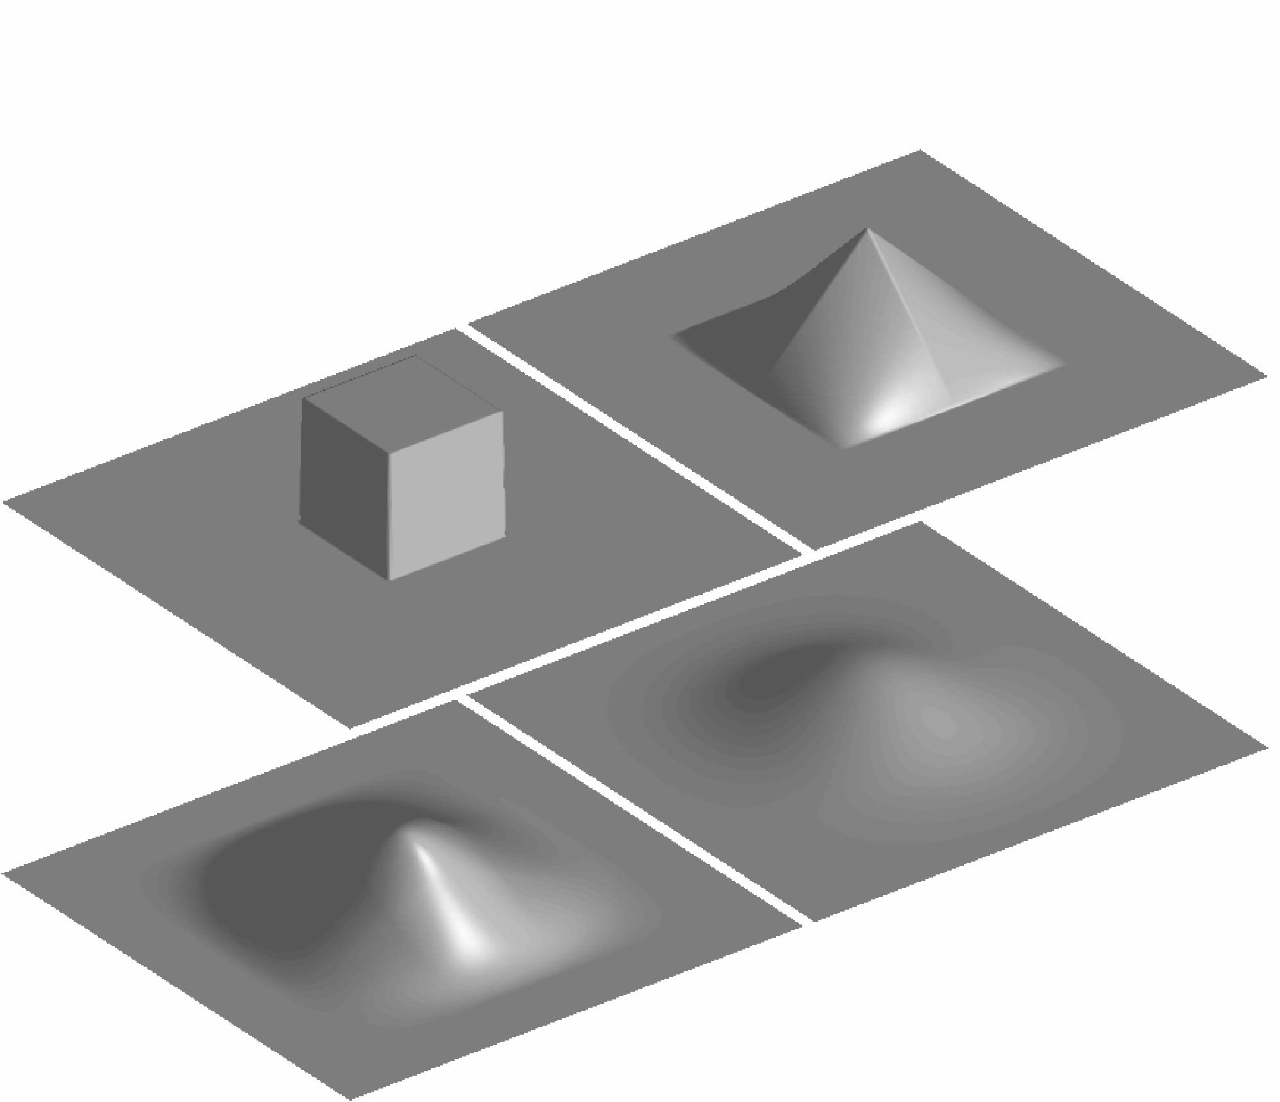
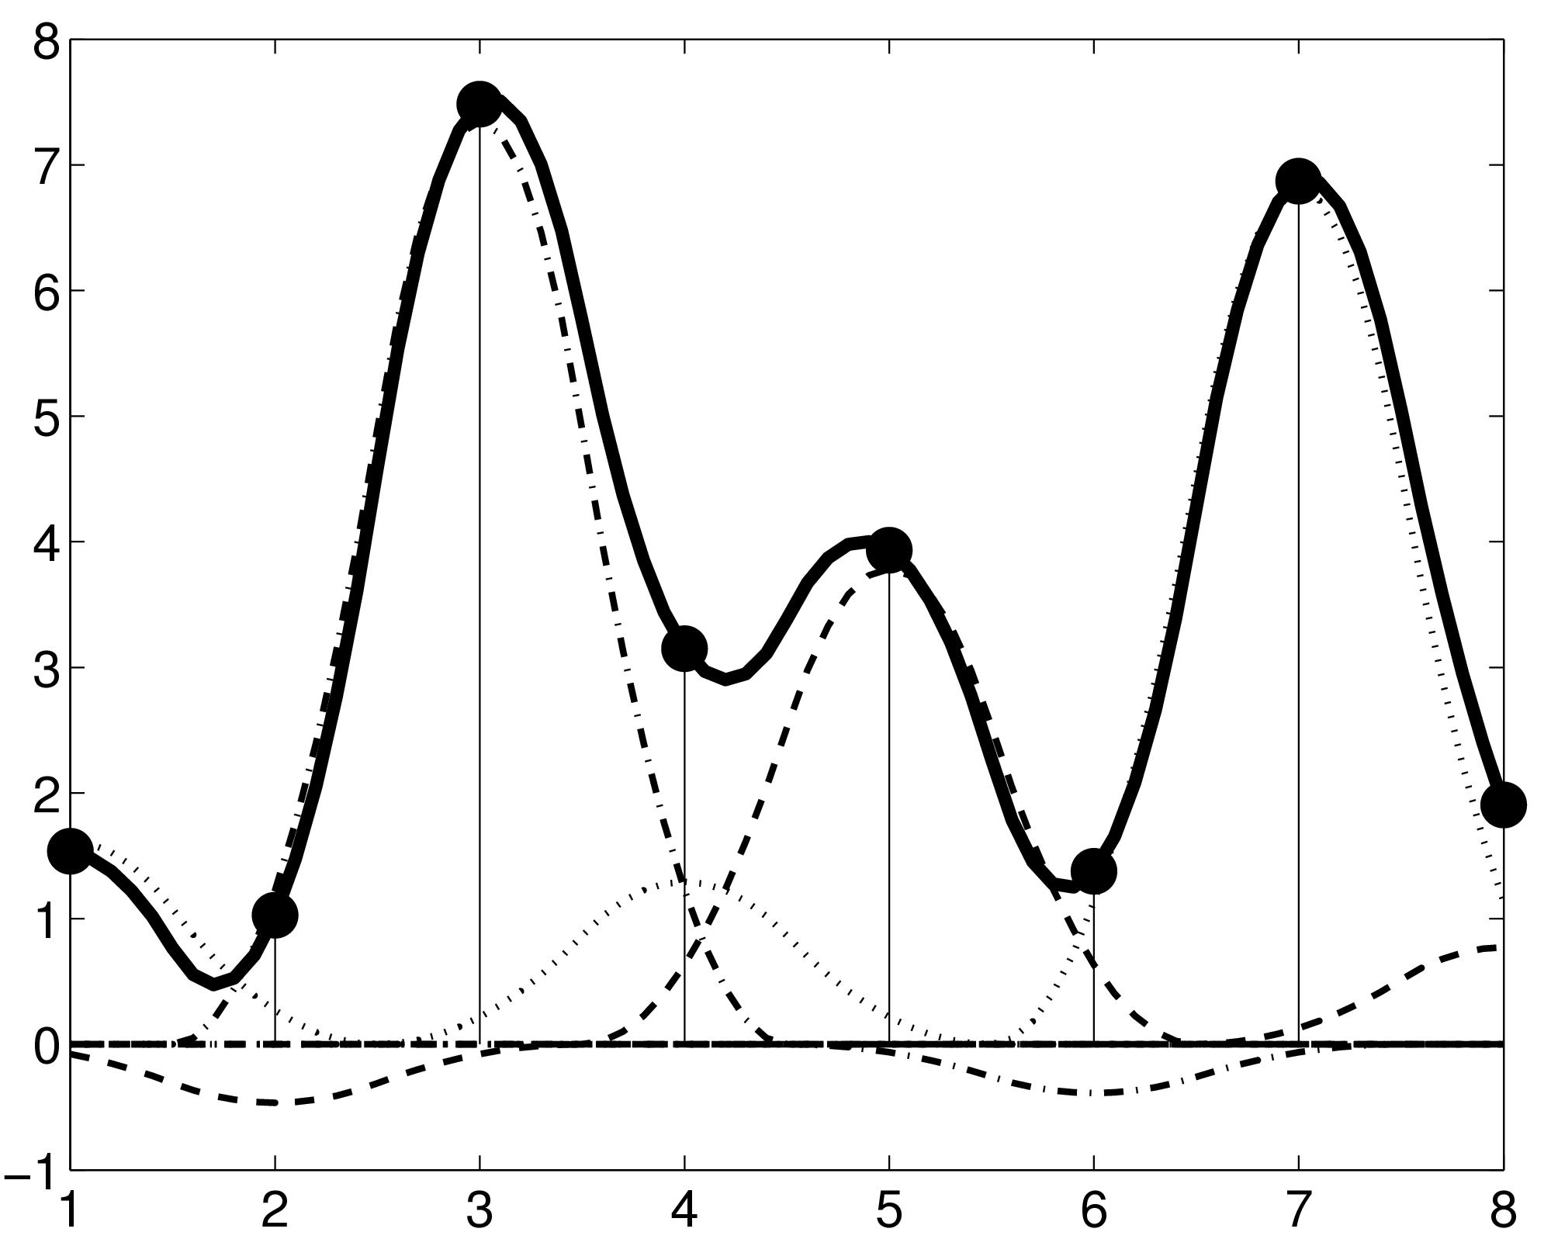
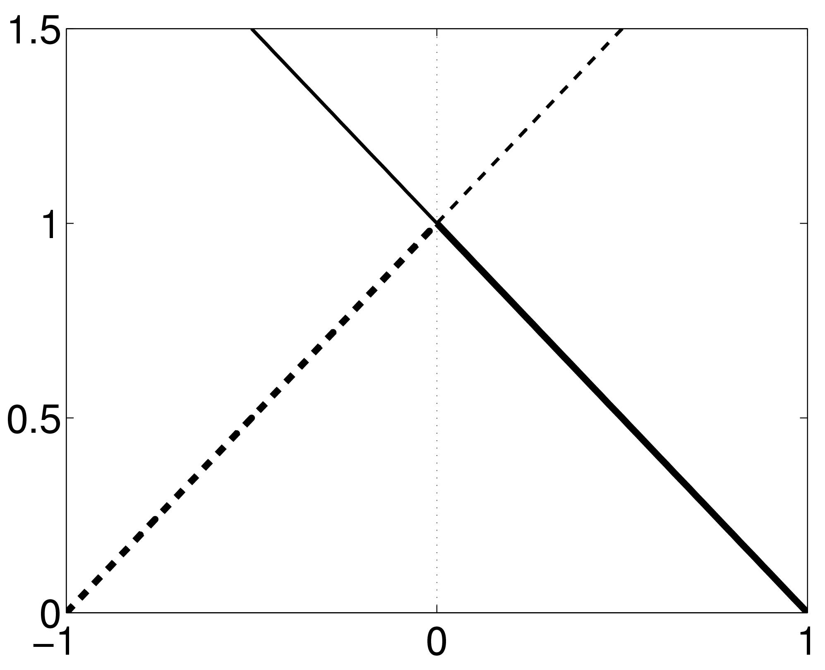
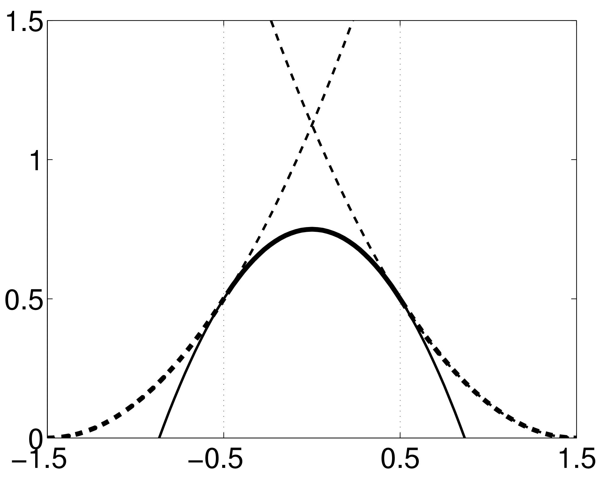
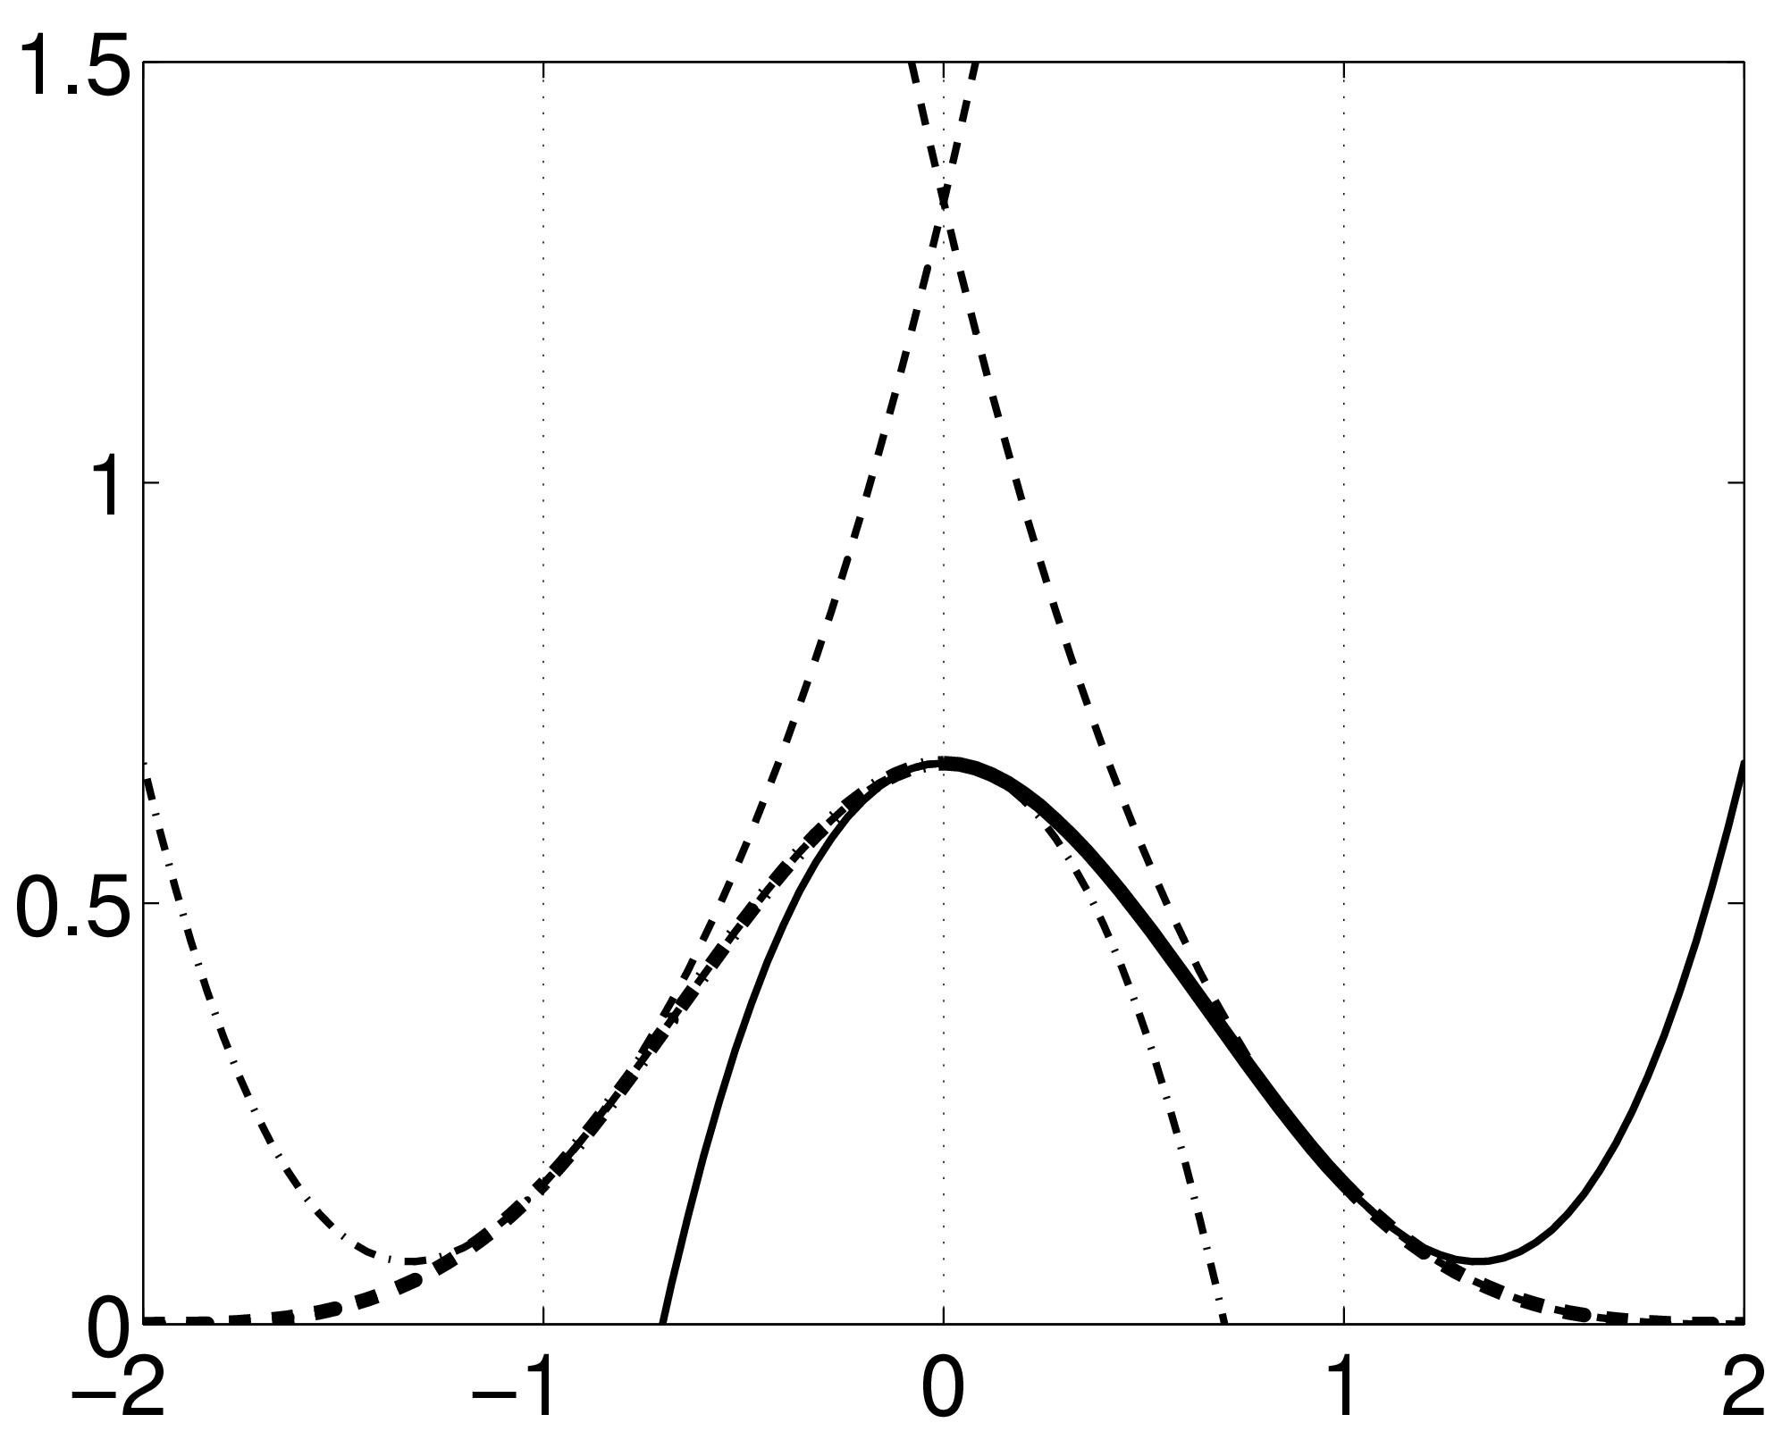
B-spline Interpolation
A continuous function is represented by a linear combination of basis functions
2D B-spline basis functions of degrees 0, 1, 2 and 3
B-splines are piecewise polynomials
Nearest neighbour and trilinear interpolation are the same as B-spline interpolation with degrees 0 and 1.

Slide 17
Quantifying image alignment
Registration intuitively relies on the concept of aligning images to increase their similarity
This needs to be mathematically formalised
We need practical way(s) of measuring similarity
Using interpolation we can find the intensity at equivalent voxels
(equivalent according to the current estimates of the transformation parameters)

Slide 18
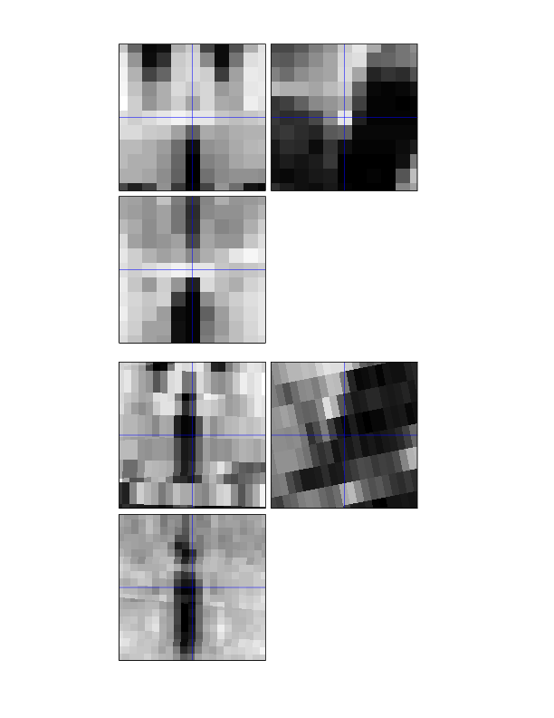

Voxel similarity measures
Pairs of voxel intensities
Mean-squared difference
Correlation coefficient
Joint histogram measures

Slide 19
Automatic image registration
Quantifying the quality of the alignment with a measure of image similarity allows computational estimation of transformation parameters
This is the basis of both realignment and coregistration in SPM
Allowing more complex geometric transformations or warps leads to more flexible spatial normalisation
Automating registration requires optimisation...

Slide 20
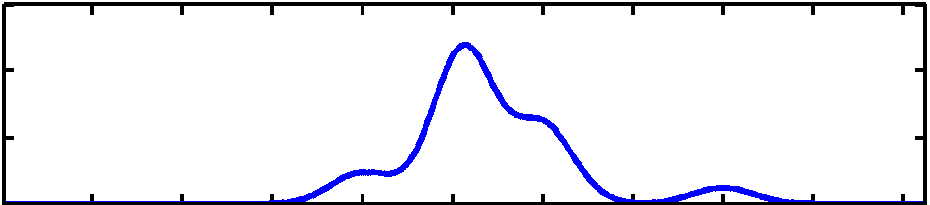
Optimisation
Find the “best” parameters according to an “objective function” (minimised or maximised)
Objective functions can often be related to a probabilistic model (Bayes -> MAP -> ML -> LSQ)
Global optimum (most probable)
Objective function
Local optimum
Local optimum
Value of parameter

Slide 21
Contents
Registration basics
Motion and realignment
Inter-modal coregistration
Spatial normalisation
Unified segmentation
Gaussian smoothing

Slide 22
Motion in fMRI
Can be a major problem
Increase residual variance and reduce sensitivity
Data may get completely lost with sudden movements
Movements may be correlated with the task
Try to minimise movement (don’t scan for too long!)
Motion correction using realignment
Each volume rigidly registered to reference
Least squares objective function
Realigned images must be resliced for analysis
Not necessary if they will be normalised anyway

Slide 23
Residual Errors from aligned fMRI
Slices are not acquired simultaneously
rapid movements not accounted for by rigid body model
Image artefacts may not move according to a rigid body model
image distortion, image dropout, Nyquist ghost
Gaps between slices can cause aliasing artefacts
Re-sampling can introduce interpolation errors
especially tri-linear interpolation
Functions of the estimated motion parameters can be modelled as confounds in subsequent analyses

Slide 24
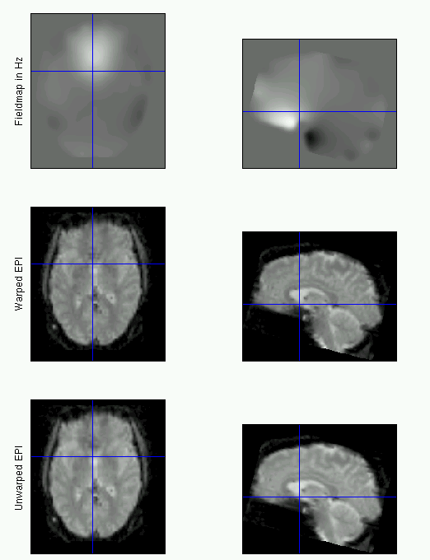
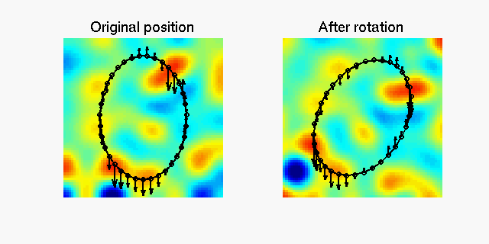
fMRI movement by distortion interaction
Subject disrupts B0 field, rendering it inhomogeneous
distortions occur along the phase-encoding direction
Subject moves during EPI time series
Distortions vary with subject position
shape varies (non-rigidly)

Slide 25
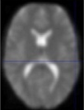
Correcting for distortion changes using Unwarp
Estimate reference from mean of all scans.
Estimate new distortion fields for each image:
estimate rate of change of field with respect to the current estimate of movement parameters in pitch and roll.
Unwarp time series.
Estimate movement parameters.
Δϕ
+Δθ
Andersson et al, 2001

Slide 26
Contents
Registration basics
Motion and realignment
Inter-modal coregistration
Spatial normalisation
Unified segmentation
Gaussian smoothing

Slide 27
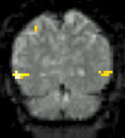
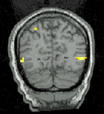
Inter-modal coregistration
Match images from same subject but different modalities:
anatomical localisation of single subject activations
achieve more precise spatial normalisation of functional image using anatomical image.

Slide 28
Inter-modal similarity measures
Seek to measure shared information in some sense
For example Mutual Information and related metrics
Statistical measure of information – entropy
Entropy is a property of a probability distribution
Probabilities can be estimated from histograms
Mutual information considers both images’ histograms and their joint histogram

Slide 29
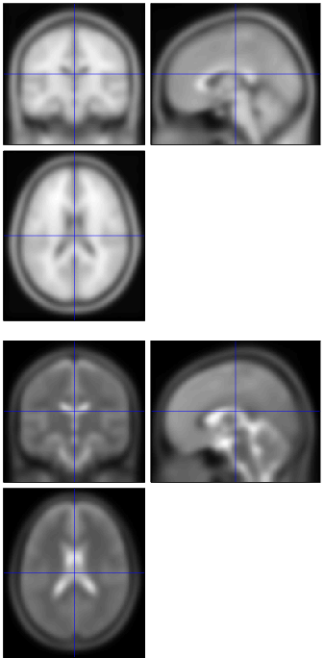
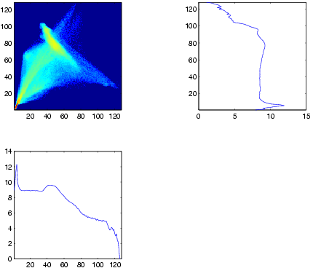
Joint and marginal histograms

Slide 30
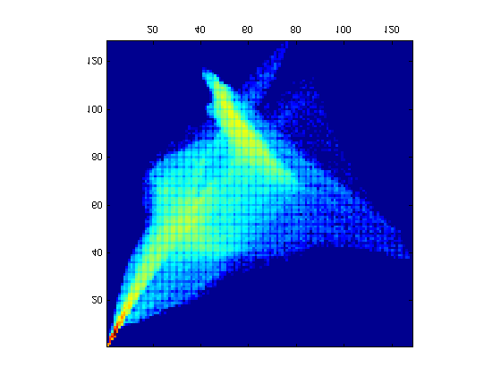
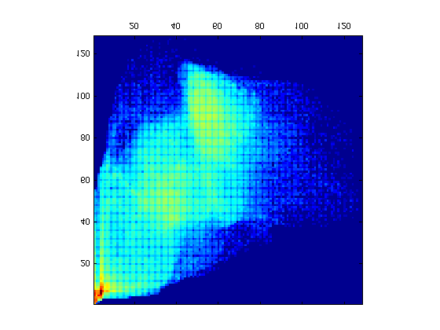
Joint histogram based registration
Initially registered T1 and T2 templates
After deliberate misregistration (10mm relative x-translation)
Joint histogram sharpness correlates with image alignment Mutual information and related measures attempt to quantify this

Slide 31
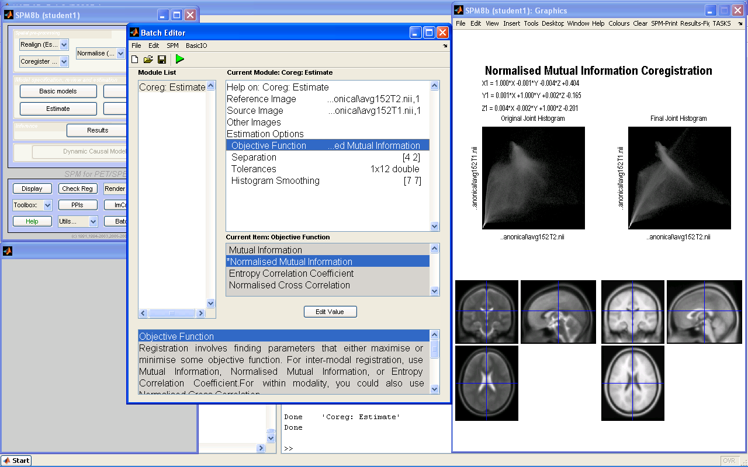

Slide 32
Contents
Registration basics
Motion and realignment
Inter-modal coregistration
Spatial normalisation
Unified segmentation
Gaussian smoothing

Slide 33
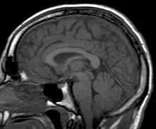
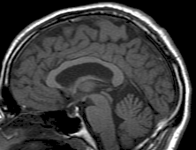
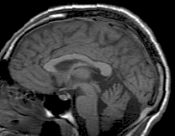
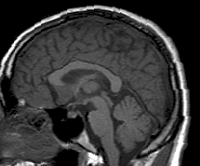
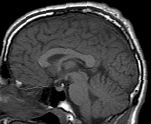
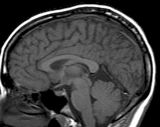
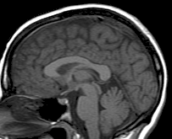
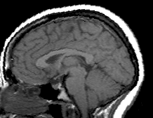
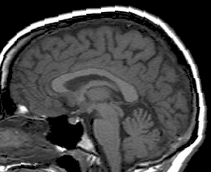
Spatial Normalisation

Slide 34
Spatial Normalisation - Reasons
Inter-subject averaging
Increase sensitivity with more subjects
Fixed-effects analysis
Extrapolate findings to the population as a whole
Mixed-effects analysis
Make results from different studies comparable by aligning them to standard space
e.g. The T&T convention, using the MNI template

Slide 35
Spatial Normalisation – Limitations
Seek to match functionally homologous regions, but...
No exact match between structure and function
Different cortices can have different folding patterns
Challenging high-dimensional optimisation
Many local optima
Compromise
Correct relatively large-scale variability (sizes of structures)
Smooth over finer-scale residual differences

Slide 36
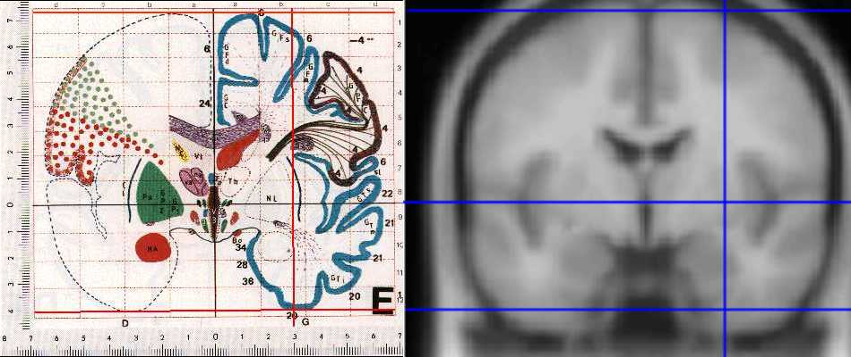
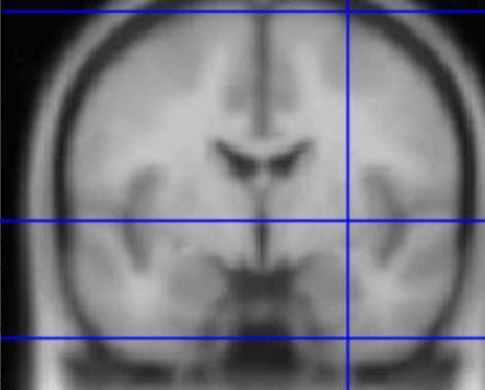
Standard spaces
The Talairach Atlas
The MNI/ICBM AVG152 Template
The MNI template follows the convention of T&T, but doesn’t match the particular brain Recommended reading: http://imaging.mrc-cbu.cam.ac.uk/imaging/MniTalairach
Notes:
Also DICOM scanner-based voxel-world mapping

Slide 37
Coordinate system sense
Analyze™ files are stored in a left-handed system
Talairach space has the opposite (right-handed) sense
Mapping between them requires a reflection or “flip”
Affine transform with a negative determinant
z
z
x
y
y
y
z
x
x
Rotated example
Notes:
On the left, the x-axis has been flipped. Note that we can’t rotate between the resulting coordinate systems, whereas we can between the right-hand one and the boxed one.

Slide 38
Spatial Normalisation – Procedure
Starts with an affine transformation
Fits overall shape and size, good initialisation
Refines registration with non-linear deformations/warps
Algorithm simultaneously minimises
Mean-squared difference (intramodal, cf. Unified Seg.)
Squared distance between parameters and their expected values (more on this soon…)
Requires appropriate template(s)

Slide 39
Spatial Normalisation – Initial Affine
12 degree of freedom (DF)
3 DF for translation
3 DF for rotation
3 DF for scaling or zooming
3 DF for shearing or skewing

Slide 40
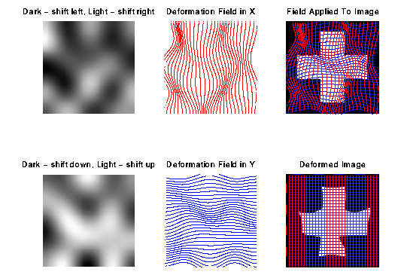
Spatial Normalisation – Warping
Deformations are modelled with a linear combination of non-linear basis functions

Slide 41
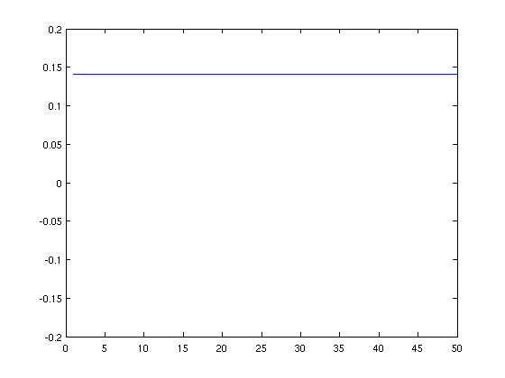
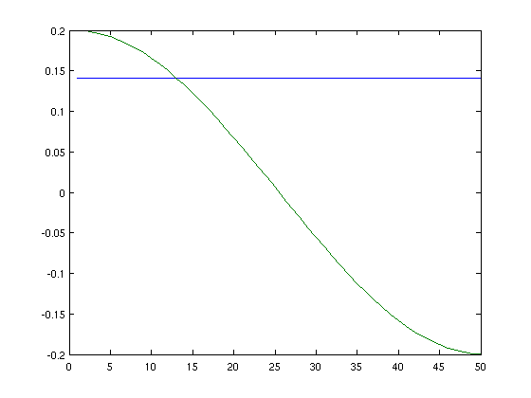
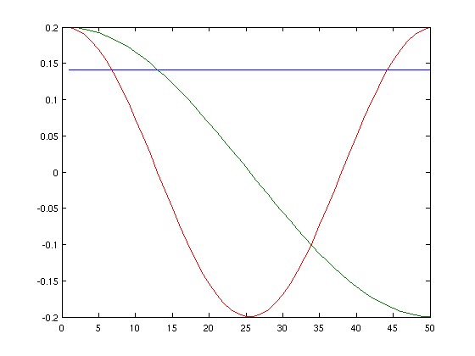
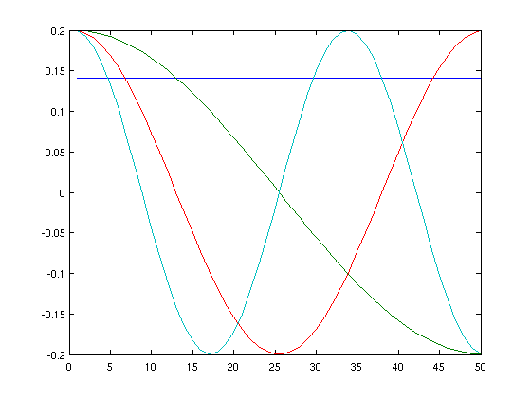
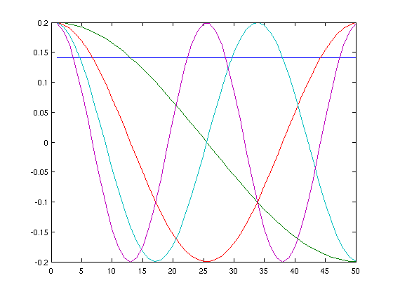
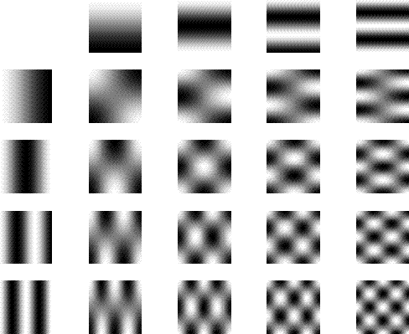
Spatial Normalisation – DCT basis
The lowest frequencies of a 3D discrete cosine transform (DCT) provide a smooth basis
spm_dctmtx(5,5)
ans =
0.447 0.602 0.512 0.372 0.195
0.447 0.372 -0.195 -0.602 -0.512
0.447 0.000 -0.633 -0.000 0.633
0.447 -0.372 -0.195 0.602 -0.512
0.447 -0.601 0.512 -0.372 0.195
% Note, pinv(x)=x’, projection P=x*x’ P{n} = x(:,1:n)*x(:,1:n)’
P{N} == eye(N)
P{n<N} projects to smoother approx.
plot(spm_dctmtx(50, 5))
Notes:
Analytical derivatives available: d(cos(x)) = -sin(x)dx
Note, plot appears continuous because 50 samples Note, although discretised, still orthogonal

Slide 42
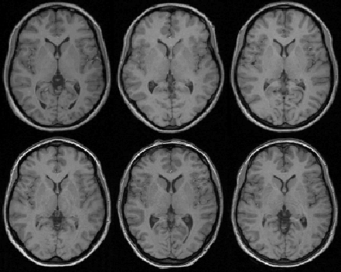
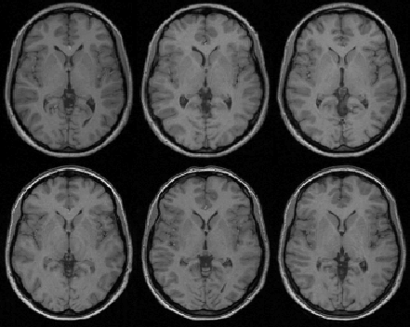
Spatial Normalisation – Results
Affine registration
Non-linear registration

Slide 43

Spatial Normalisation – Overfitting
Without regularisation, the non-linear normalisation can introduce unnecessary deformation
Affine registration.
(SSE = 472.1)
Template
image
Non-linear
registration
without
regularisation.
(SSE = 287.3)
Non-linear
registration
using
regularisation.
(SSE = 302.7)

Slide 44
Spatial Normalisation – regularisation
The “best” parameters according to the objective function may not be realistic
In addition to similarity, regularisation terms or constraints are often needed to ensure a reasonable solution is found
Also helps avoid poor local optima
Can be considered as priors in a Bayesian framework, e.g. converting ML to MAP:
log(posterior) = log(likelihood) + log(prior) + c

Slide 45
Contents
Registration basics
Motion and realignment
Inter-modal coregistration
Spatial normalisation
Unified segmentation
Gaussian smoothing

Slide 46
Unified segmentation and normalisation
MRI imperfections make normalisation harder
Noise, artefacts, partial volume effect
Intensity inhomogeneity or “bias” field
Differences between sequences
Normalising segmented tissue maps should be more robust and precise than using the original images ...
… Tissue segmentation benefits from spatially-aligned prior tissue probability maps (from other segmentations)
This circularity motivates simultaneous segmentation and normalisation in a unified model

Slide 47
Summary of the unified model
SPM8 implements a generative model
Principled Bayesian probabilistic formulation
Gaussian mixture model segmentation with deformable tissue probability maps (priors)
The inverse of the transformation that aligns the TPMs can be used to normalise the original image
Bias correction is included within the model

Slide 48
Mixture of Gaussians (MOG)
Classification is based on a Mixture of Gaussians model (MOG), which represents the intensity probability density by a number of Gaussian distributions.
Frequency
Image Intensity

Slide 49


Modelling inhomogeneity
A multiplicative bias field is modelled as a linear combination of basis functions.
Corrupted image
Bias Field
Corrected image

Slide 50
Tissue Probability Maps
Tissue probability maps (TPMs) are used as the prior, instead of the proportion of voxels in each class
ICBM Tissue Probabilistic Atlases. These tissue probability maps are kindly provided by the International Consortium for Brain Mapping, John C. Mazziotta and Arthur W. Toga.

Slide 51

Deforming the Tissue Probability Maps
Tissue probability images are warped to match the subject
The inverse transform warps to the TPMs

Slide 52

Spatially normalised BrainWeb phantoms (T1, T2, PD)
Tissue probability maps of GM and WM
Cocosco, Kollokian, Kwan & Evans. “BrainWeb: Online Interface to a 3D MRI Simulated Brain Database”. NeuroImage 5(4):S425 (1997)

Slide 53
Contents
Registration basics
Motion and realignment
Inter-modal coregistration
Spatial normalisation
Unified segmentation
Gaussian smoothing

Slide 54
Smoothing
Why would we deliberately blur the data?
Improves spatial overlap by blurring over minor anatomical differences and registration errors
Averaging neighbouring voxels suppresses noise
Increases sensitivity to effects of similar scale to kernel (matched filter theorem)
Makes data more normally distributed (central limit theorem)
Reduces the effective number of multiple comparisons
How is it implemented?
Convolution with a 3D Gaussian kernel, of specified full-width at half-maximum (FWHM) in mm
Notes:
Spatial normalisation is never exact, so homologous regions can never be precisely registered. Furthermore, due to the noisy nature of the BOLD signal, activations from different scans can be slightly offset, thereby cancelling each other out. Smoothing spreads out the different areas and reduces the discrepancy.

Slide 55







Example of
Gaussian smoothing in one-dimension
The Gaussian kernel is separable we can smooth 2D data with two 1D convolutions.
Generalisation to 3D is simple and efficient
A 2D Gaussian Kernel
Notes:
(A convolution is a kind of very general moving average.) First you convolve in one direction, than in the other two directions.
A general rule of thumb is to use a smoothing kernel of 6 mm for single subject analyses and a smoothing kernel of 8 or 10 mm when you are going to do a group analysis.

Slide 56
References
Friston et al. Spatial registration and normalisation of images. Human Brain Mapping 3:165-189 (1995).
Collignon et al. Automated multi-modality image registration based on information theory. IPMI’95 pp 263-274 (1995).
Ashburner et al. Incorporating prior knowledge into image registration. NeuroImage 6:344-352 (1997).
Ashburner & Friston. Nonlinear spatial normalisation using basis functions. Human Brain Mapping 7:254-266 (1999).
Thévenaz et al. Interpolation revisited. IEEE Trans. Med. Imaging 19:739-758 (2000).
Andersson et al. Modeling geometric deformations in EPI time series. Neuroimage 13:903-919 (2001).
Ashburner & Friston. Unified Segmentation. NeuroImage 26:839-851 (2005).
Ashburner. A Fast Diffeomorphic Image Registration Algorithm. NeuroImage 38:95-113 (2007).

Slide 57
Preprocessing overview
Input
Output
fMRI time-series
Anatomical MRI
TPMs
Segmentation
Transformation
(seg_sn.mat)
Kernel
REALIGN
COREG
SEGMENT
NORM WRITE
SMOOTH
Mean functional
(Headers changed)
Motion corrected
MNI Space
ANALYSIS

Slide 58
Preprocessing (fMRI only)
Input
Output
fMRI time-series
TPMs
Segmentation
Transformation
(seg_sn.mat)
Mean functional
Kernel
REALIGN
SEGMENT
NORM WRITE
SMOOTH
Motion corrected
MNI Space
ANALYSIS

Slide 59
Preprocessing overview
Input
Output
fMRI time-series
Anatomical MRI
TPMs
Segmentation
Transformation
(seg_sn.mat)
Kernel
REALIGN
COREG
SEGMENT
NORM WRITE
SMOOTH
Mean functional
(Headers changed)
Motion corrected
MNI Space
ANALYSIS

Slide 60


Preprocessing with Dartel
...
fMRI time-series
Anatomical MRI
TPMs
DARTEL CREATE TEMPLATE
REALIGN
COREG
SEGMENT
DARTEL NORM 2 MNI & SMOOTH
Mean functional
(Headers changed)
Motion corrected
ANALYSIS

